Slide 1
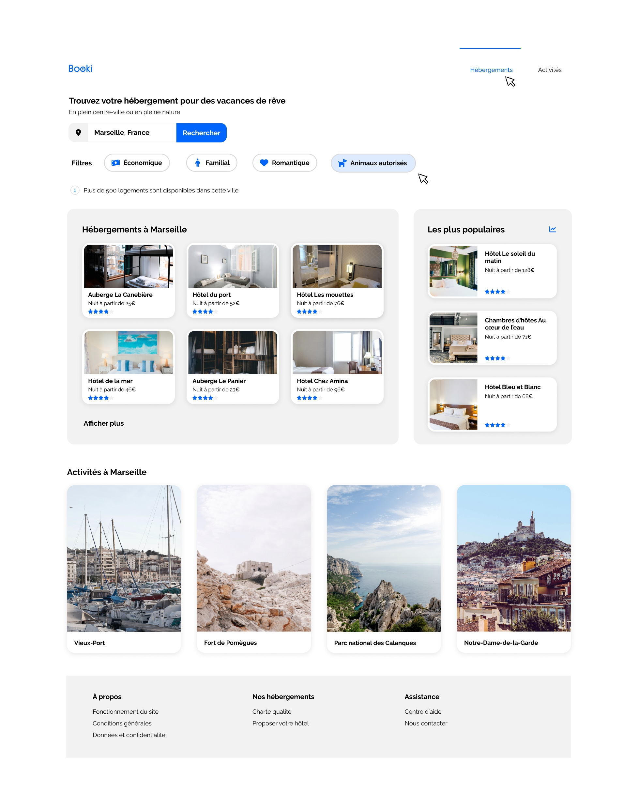
header
header1
h1b
h1a
header2
h1
header3
header4
header5
header6
Div class = Box1
h1
h1
Section class=hebergements
Section class=lespluspopulaires
h1
Section class=3
Div class = Box2
footer

